Slide 1
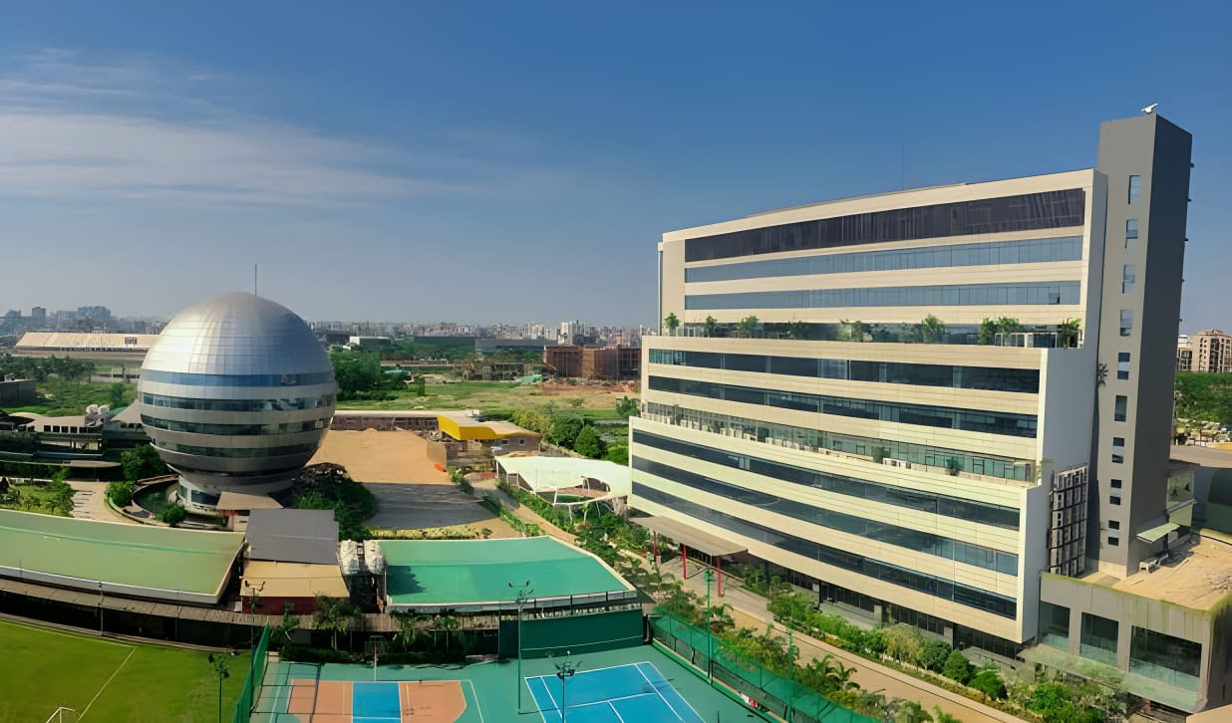

AMERICAN INTERNATIONAL UNIVERSITY BANGLADESH (AIUB)
WELCOME TO OUR
PRESENTATION
Course Title : Introduction to Database
Course Teacher : Md. Masum Billah

Slide 2

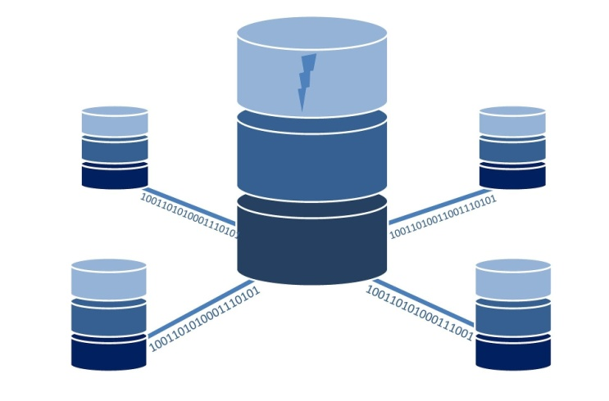
Airlines
Management
System
MAHMUDUL HASAN
SAJIB MONDOL
MD RIAS-UL

Slide 3

Outline:
Introduction
ER-Diagram
Relational Model
Normalization
Table Creation
Values Insertion
Query Writing
Conclusion

Slide 4

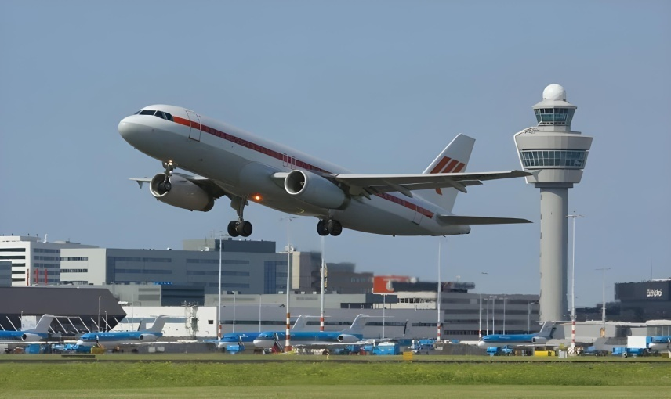
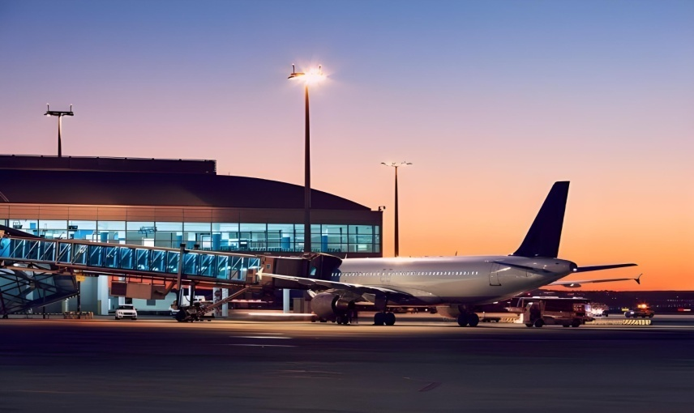
Introduction
An Airlines Management System in a database is like the control centre for an airline. It helps keep track of flights, passengers, bookings, and crew assignments. Think of it as the behind-the-scenes tool that makes sure everything runs smoothly for both the airline and its customers.

Slide 5
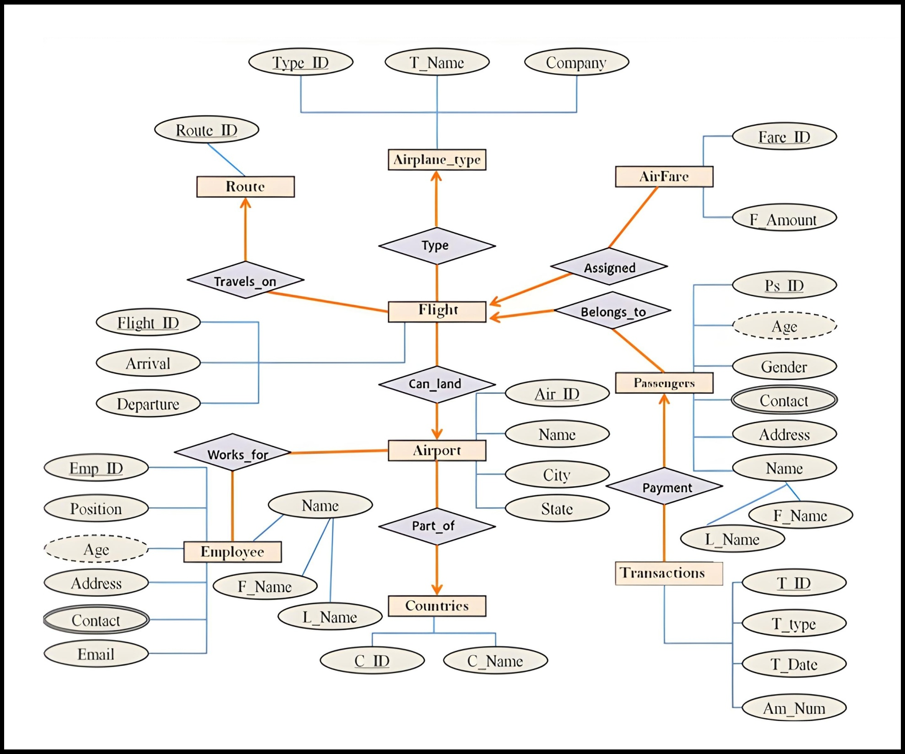
ER-Diagram

Slide 6
Relational Model
Airplane-Type (Type-ID, Type-Name, Capacity)
Airport (Airport-ID, Airport-Name, Location)
Countries (Country-ID, Country-Name)
Route (Route-ID, Source-Airport-ID*, Destination-Airport-ID*)
Flight (Flight-ID, Departure-Time, Arrival-Time, Route-ID*, Airplane-Type-ID*)
AirFare (AirFare-ID, Fare-Amount, Flight-ID*)
Employee (Employee-ID, First-Name, Last-Name, Position, Age, Phone, Address, Email, Airport-ID*)
Passenger (Passenger-ID, First-Name, Last-Name, Age, Gender, Phone, Address, Country-ID*)
Transaction (Transaction-ID, Transaction-Type, Transaction-Date, Amount-Number, Passenger-ID*, Flight-ID*)

Slide 7
Normalization
1NF(First Normal From)
•Eliminate repeating groups in individualtables.
•Create a separate table for each set of related •Identify each set of related data with a primary key.
2NF(Second Normal From)
• The relation must already be in the First Normal Form (1NF).
• No Partial Dependency, non key attributes depend entire primary key.
3NF(Third Normal From)
• The relation must already be in the (2NF).
• No Transitive Dependency, A non-prime (non-key)
attribute should not depend on another non-prime attribute. In other words, if a non-key attribute depends on another non-key attribute, it must be moved to its own relation.
Normalization is the process of organizing data in a database. It includes creating tables and establishing relationships between those tables according rules designed both to protect the data and to make the database more flexible by eliminating redundancy and inconsistent dependency.
UNF (Unnormalized From)
•Initial stage of database design.
•Data may contain redundancy and anomalies. •Data is organized in single table with repeating groups

Slide 8
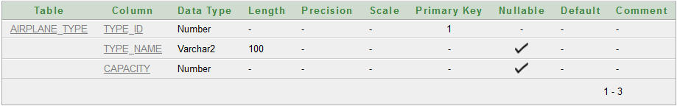
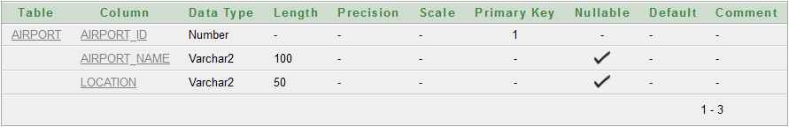
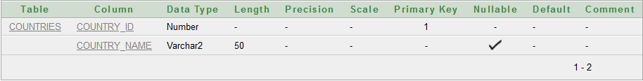
Table Creation
CREATE TABLE Airplane_Type (
Type_ID NUMBER PRIMARY KEY,
Type_Name VARCHAR2(100),
Capacity NUMBER
);
CREATE TABLE Airport (
Airport_ID NUMBER PRIMARY KEY,
Airport_Name VARCHAR2(100),
Location VARCHAR2(50)
);
CREATE TABLE Countries (
Country_ID NUMBER PRIMARY KEY,
Country_Name VARCHAR2(50)
);

Slide 9
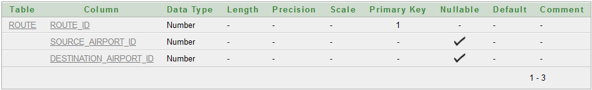
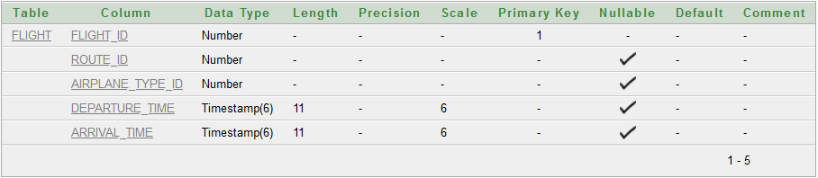
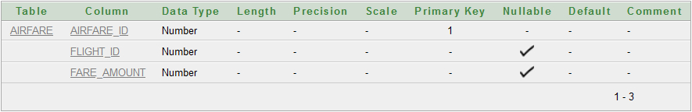
CREATE TABLE Route (
Route_ID NUMBER PRIMARY KEY,
Source_Airport_ID NUMBER REFERENCES Airport(Airport_ID),
Destination_Airport_ID NUMBER REFERENCES Airport(Airport_ID)
);
CREATE TABLE Flight (
Flight_ID NUMBER PRIMARY KEY,
Route_ID NUMBER REFERENCES Route(Route_ID),
Airplane_Type_ID NUMBER REFERENCES Airplane_Type(Type_ID),
Departure_Time TIMESTAMP,
Arrival_Time TIMESTAMP
);
CREATE TABLE Airfare (
Airfare_ID NUMBER PRIMARY KEY,
Flight_ID NUMBER REFERENCES Flight(Flight_ID),
Fare_Amount NUMBER
);

Slide 10
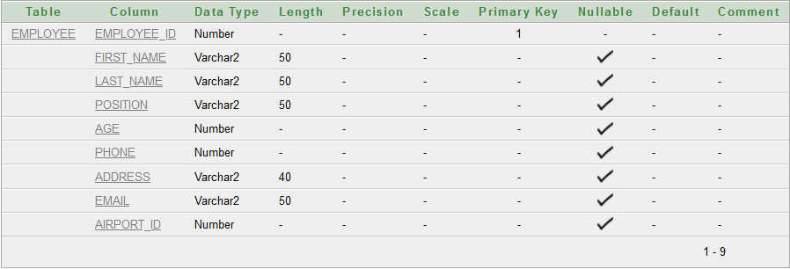
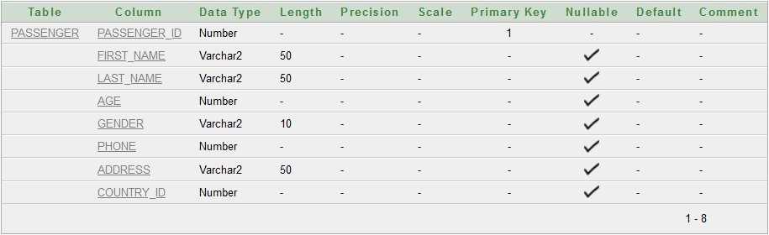
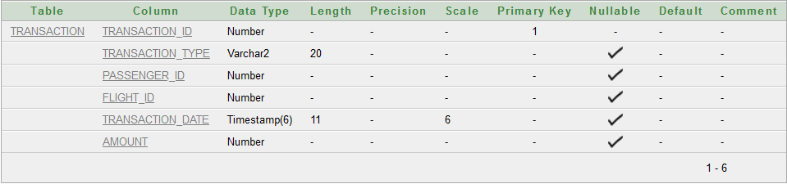
CREATE TABLE Employee (
Employee_ID NUMBER PRIMARY KEY,
First_Name VARCHAR2(50), Last_Name VARCHAR2(50),Position VARCHAR2(50),
Age NUMBER, Phone NUMBER,
Address VARCHAR2(40), Email VARCHAR2(50),
Airport_ID NUMBER REFERENCES Airport(Airport_ID)
);
CREATE TABLE Passenger(
Passenger_ID NUMBER PRIMARY KEY,
First_Name VARCHAR2(50), Last_Name VARCHAR2(50), Age NUMBER, Gender VARCHAR2(10),Phone NUMBER,Address VARCHAR(50), Country_ID NUMBER REFERENCES Countries(Country_ID)
);
CREATE TABLE Transaction (
Transaction_ID NUMBER PRIMARY KEY,
Transaction_Type VARCHAR2(20),
Passenger_ID NUMBER REFERENCES Passenger(Passenger_ID), Flight_ID NUMBER REFERENCES Flight(Flight_ID),Transaction
Date TIMESTAMP, Amount NUMBER
);

Slide 11
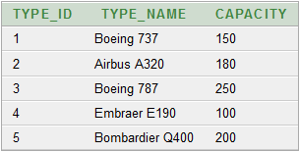
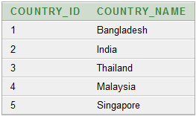
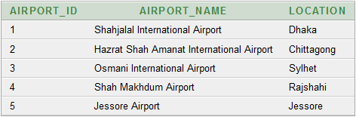
Value Insertion
INSERT INTO Airplane_Type VALUES (1, 'Boeing 737', 150);
INSERT INTO Airplane_Type VALUES (2, 'Airbus A320', 180);
INSERT INTO Airplane_Type VALUES (3, 'Boeing 787', 250);
INSERT INTO Airplane_Type VALUES ((4, 'Embraer E190', 100);
INSERT INTO Airplane_Type VALUES (5, 'Bombardier Q400', 200);
INSERT INTO Airport VALUES (1, 'Shahjalal International Air', 'Dhaka');
INSERT INTO Airport VALUES (2, 'Hazrat Shah Amanat ', 'Chittagong');
INSERT INTO Airport VALUES (3, 'Osmani International Airp', 'Sylhet');
INSERT INTO Airport VALUES (4, 'Shah Makhdum Airport', 'Rajshahi');
INSERT INTO Airport VALUES (5, 'Jessore Airport', 'Jessore');
INSERT INTO Countries VALUES (1, 'Bangladesh');
INSERT INTO Countries VALUES (2, 'India');
INSERT INTO Countries VALUES (3, 'Thailand');
INSERT INTO Countries VALUES (4, 'Malaysia');
INSERT INTO Countries VALUES (5, 'Singapore');

Slide 12
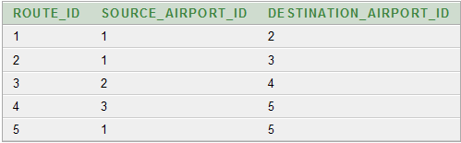
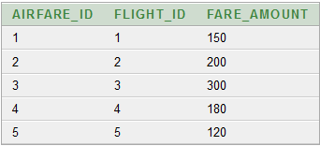
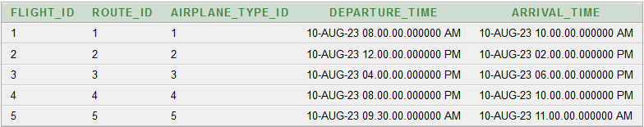
INSERT INTO Route VALUES (1, 1, 2);
INSERT INTO Route VALUES (2, 1, 3);
INSERT INTO Route VALUES (3, 2, 4);
INSERT INTO Route VALUES (4, 3, 5);
INSERT INTO Route VALUES (5, 1, 5);
INSERT INTO Flight VALUES (1, 1, 1, TO_TIMESTAMP('2023-08-10 08:00:00', 'YYYY-MM-DD HH24:MI:SS'), TO_TIMESTAMP('2023-08-10 10:00:00', 'YYYY-MM-DD HH24:MI:SS'));
INSERT INTO Flight VALUES(2, 2, 2, TO_TIMESTAMP('2023-08-10 12:00:00', 'YYYY-MM-DD HH24:MI:SS'), TO_TIMESTAMP('2023-08-10 14:00:00', 'YYYY-MM-DD HH24:MI:SS'));
INSERT INTO Flight VALUES(3, 3, 3, TO_TIMESTAMP('2023-08-10 16:00:00', 'YYYY-MM-DD HH24:MI:SS'), TO_TIMESTAMP('2023-08-10 18:00:00', 'YYYY-MM-DD HH24:MI:SS'));
INSERT INTO Flight VALUES(4, 4, 4, TO_TIMESTAMP('2023-08-10 20:00:00', 'YYYY-MM-DD HH24:MI:SS'), TO_TIMESTAMP('2023-08-10 22:00:00', 'YYYY-MM-DD HH24:MI:SS'));
INSERT INTO Flight VALUES(5, 5, 5, TO_TIMESTAMP('2023-08-10 09:30:00', 'YYYY-MM-DD HH24:MI:SS'), TO_TIMESTAMP('2023-08-10 11:00:00', 'YYYY-MM-DD HH24:MI:SS'));
INSERT INTO Airfare VALUES (1, 1, 150);
INSERT INTO Airfare VALUES (2, 2, 200);
INSERT INTO Airfare VALUES (3, 3, 300);
INSERT INTO Airfare VALUES (4, 4, 180);
INSERT INTO Airfare VALUES (5, 5, 120);

Slide 13
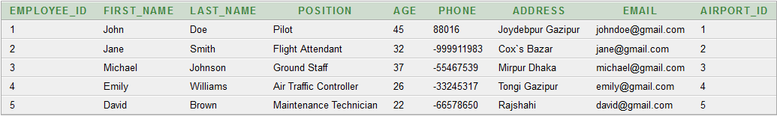
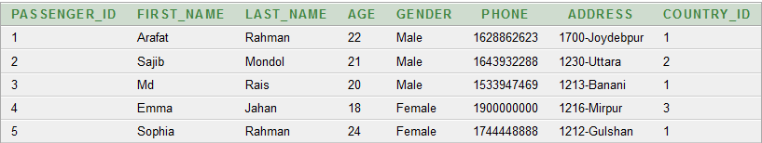
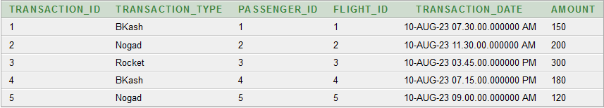
INSERT INTO Employee VALUES(1, 'John', 'Doe', 'Pilot',45, +88016-00000000, 'Joydebpur Gazipur','johndoe@gmail.com', 1);
INSERT INTO Employee VALUES(2, 'Jane', 'Smith', 'Flight Attendant',32,+88016-999999999, 'Cox`s Bazar', 'jane@gmail.com', 2);
INSERT INTO Employee VALUES(3, 'Michael', 'Johnson', 'Ground Staff',37,+88016-55555555, 'Mirpur Dhaka', 'michael@gmail.com', 3);
INSERT INTO Employee VALUES(4, 'Emily', 'Williams', 'Air Traffic Controller',26,+88016-33333333, 'Tongi Gazipur', 'emily@gmail.com', 4);
INSERT INTO Employee VALUES(5, 'David', 'Brown', 'Maintenance Technician',22,+88016-66666666, 'Rajshahi', 'david@gmail.com', 5);
INSERT INTO Passenger VALUES (1, 'Arafat', 'Rahman', 22, 'Male', 01628862623, '1700-Joydebpur', 1);
INSERT INTO Passenger VALUES (2, 'Sajib', 'Mondol', 21, 'Male', 01643932288, '1230-Uttara', 2);
INSERT INTO Passenger VALUES (3, 'Md', 'Rais', 20, 'Male', 01533947469, '1213-Banani', 1);
INSERT INTO Passenger VALUES (4, 'Emma', 'Jahan', 18, 'Female', 01900000000, '1216-Mirpur', 3);
INSERT INTO Passenger VALUES (5, 'Sophia', 'Rahman', 24, 'Female', 01744448888, '1212-Gulshan', 1);
INSERT INTO Transaction VALUES (1,'Bikash', 1, 1, TO_TIMESTAMP('2023-08-10 07:30:00', 'YYYY-MM-DD HH24:MI:SS'), 150);
INSERT INTO Transaction VALUES (2,'Nogod', 2, 2, TO_TIMESTAMP('2023-08-10 11:30:00', 'YYYY-MM-DD HH24:MI:SS'), 200);
INSERT INTO Transaction VALUES (3,'Rocket', 3, 3, TO_TIMESTAMP('2023-08-10 15:45:00', 'YYYY-MM-DD HH24:MI:SS'), 300);
INSERT INTO Transaction VALUES (4,'Bikash', 4, 4, TO_TIMESTAMP('2023-08-10 19:15:00', 'YYYY-MM-DD HH24:MI:SS'), 180);
INSERT INTO Transaction VALUES (5,'Nogod', 5, 5, TO_TIMESTAMP('2023-08-10 09:00:00', 'YYYY-MM-DD HH24:MI:SS'), 120);

Slide 14
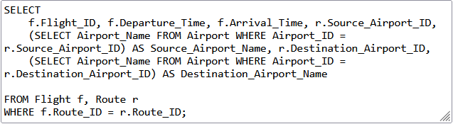
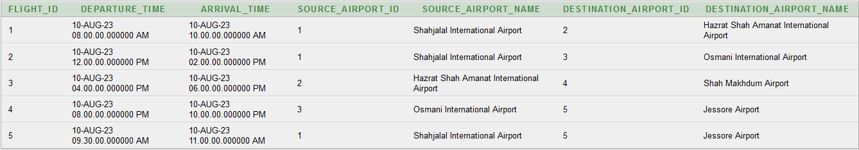
Query Writing
1.List_all_airports
2.Retrieve_flight_details_with_source_and_destination_airport_names

Slide 15
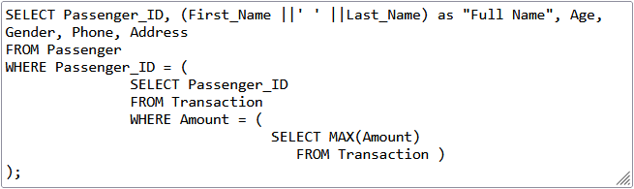
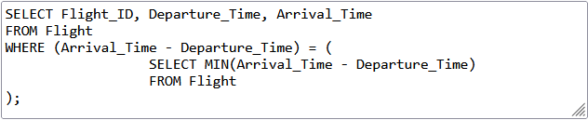

3.Find the passengers who have booked the most expensive flight.
4.Retrieve flights that have the shortest duration.

Slide 16
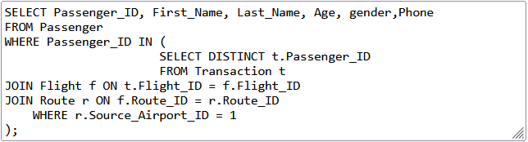
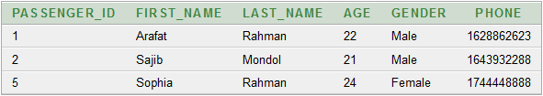
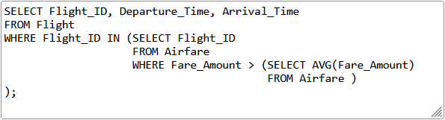

5.List passengers who have booked flights departing from a specific airport.
6. Find flights with fares higher than the average fare amount.

Slide 17
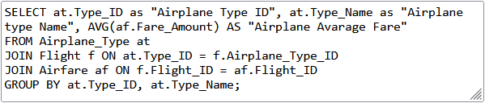
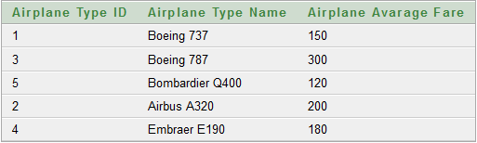
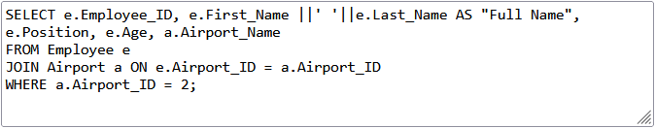
7.Find the average fare amount for each airplane_type.
8. List employees and their positions at a specific airport.

Slide 18
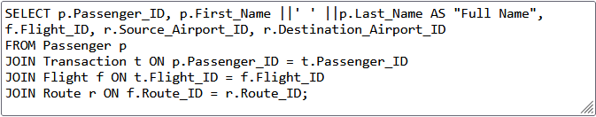
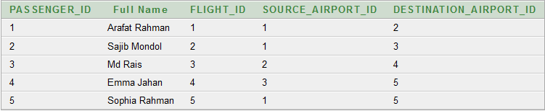
9.Retrieve passenger details along with their flights.

Slide 19
Conclusion
n summary, the ”Airlines Management System” database serves as a robust foundation for the efficient management of various aspects within an airline operation. With well defined tables representing passengers, flights, routes, airplane types, airfares, airports, employees, countries, and transactions, the database enables seamless or ganization and retrieval of essential data. Through established relationships, it ensures data integrity and empowers users to access passenger information, flight details, pricing, and staff records. This database fosters streamlined operations, accurate record-keeping, and effective decision-making for optimized airline management.

Slide 20
Thank You

